Slide 1
AI In the 2020s And Beyond
AI Foundation Models
Shuyue Jia
M.Phil. Student
City University of Hong Kong
June 29th 2023
Notes:
Let us move to the second topic: ‘Foundation Models’ for sequential decision making.
Foundation Models typically refer to large Pre-trained Language Models, large Pre-trained Vision Models, large Pre-trained Audio Models, large Pre-trained Multi-modal Models (here, multi-modal mainly focuses on two modalities: language and vision), and large Pre-trained Causal Models for sequential decision making, planning, control, and even reasoning.
These Models contain more than a billion parameters and they constitute a ‘foundational’ breakthrough technology that has the significance of Emergence and Homogenization.

Slide 2
Outline
[1970-1980] Expert System
[1980-2010] Statistical Machine Learning
[2010-2020] Deep Learning
[2020~] Foundation Models
[2023~] Advanced AI Systems

Slide 3
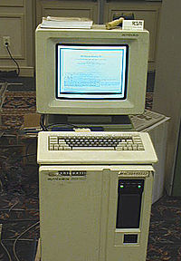
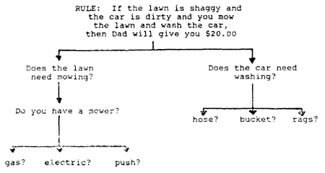
Part 1 - Expert System (1970-1980)
A Typical Expert System Architecture ^{[2]}
A Symbolics 3640 Lisp Machine (1984) ^{[1]}
If-then Rules ^{[3]} (Explicitly Programmed)
What: a computer system emulating the decision-making ability of a human expert
How: Inference Engine + Knowledge Base (Rules and Facts) designed by domain expert
Ref: https://en.wikipedia.org/wiki/Expert_system; Image Credits: Wikipedia ^{[1, 3]} and in the public domain ^{[2]}

Slide 4
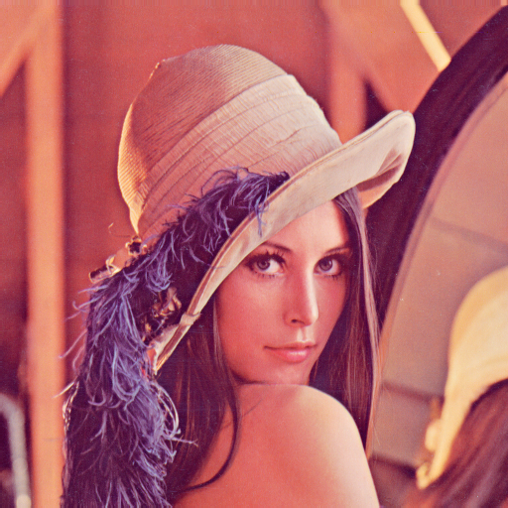
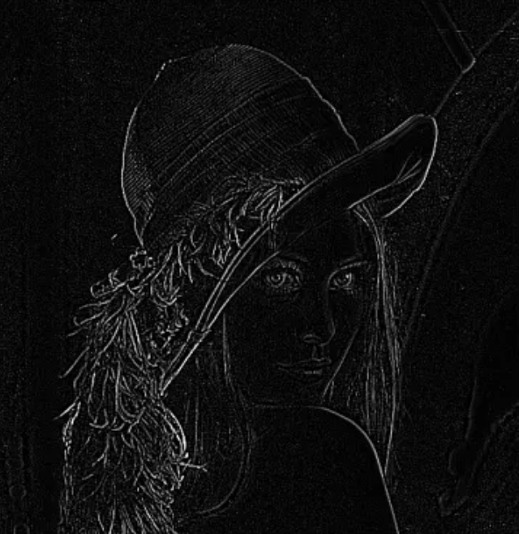
Part 2 - Statistical Machine Learning (1980-2010)
$$\left[\begin{matrix}−1 & −1 & −1 \\ −1 & 8 & −1 \\ −1 & −1 & −1\end{matrix}\right]$$
Lenna Image
Feature Map
What: give computers the ability to learn from data through a Learning Algorithm without being explicitly programmed (Arthur Samuel, 1950s)
How: Feature Extraction → Main Task Module (e.g., Classification and Regression)
Category: Supervised, Unsupervised, Semi-supervised, Self-supervised, Reinforcement
Tasks: Classification, Regression, Clustering, Dimension Reduction, etc.
Image Credits: https://medium.com/@shashikadilhani97/digital-image-processing-filters-832ec6d18a73
Notes:
feature engineering

Slide 5
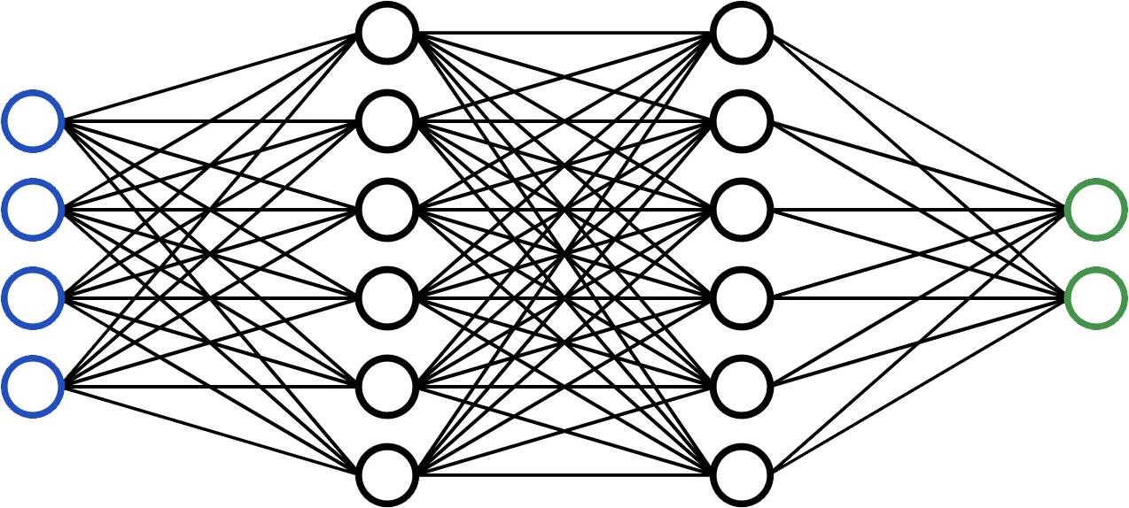
Part 3 - Deep Learning (2010-2020)
Raw Input
Output
Supervised Learning
by back-propagation
Input Layer
Hidden Layers
Output Layer
Multilayer Perceptron (MLP)
Deep: a large number of layers in modern ML models that help to
learn expressive representations of data to achieve better performance.
Image Credits: In the public domain.

Slide 6
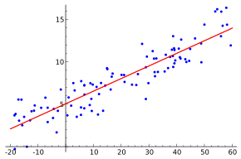
Deep Learning – Supervised Learning as an example
$$f(x)$$
error
$$g(x)$$
Minimize error$=\sum{{\left(f\left(x\right)−g(x)\right)}^{2}}$
$f\left(x\right)$ ← Neural Network
$g\left(x\right)$ ← Labels
A Regression Task
Neural Network can be used to approximate any function given Input and Output.
Image Credits: In the public domain.

Slide 7
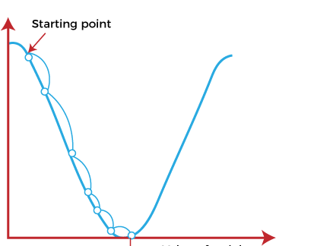
Deep Learning – Supervised Learning as an example
Error (Loss)
Gradient Descent Algorithm
$$L=\sum{{\left(f\left(x\right)−g(x)\right)}^{2}}$$
$$x^{k+1}=x^{k}−η∇L_{x}$$
$$∇L_{x}=\frac{∂\sum{{\left(f\left(x\right)−g(x)\right)}^{2}}}{∂x}$$
$$x$$
Loss Curve
Image Credits: In the public domain.

Slide 8
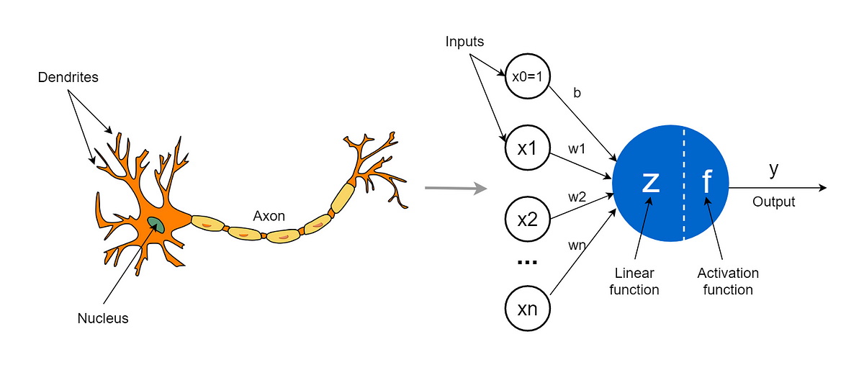
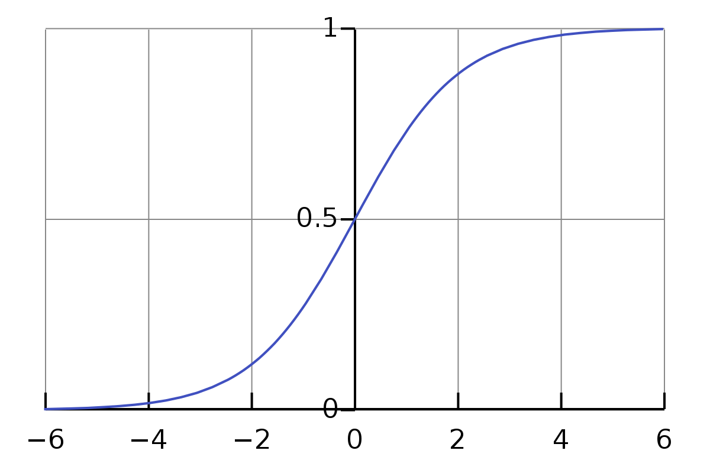
Deep Learning – Supervised Learning as an example
$$x$$
$$w$$
Convolution
+
Nonlinear Activation
A Neuron
The Mathematical Model of a Neuron
$$y=f(\sum{wx+b})$$
Weights
Biases
Image Credits: In the public domain.

Slide 9
Deep Learning – Supervised Learning as an example
$$L=\sum{{\left(y−g(x)\right)}^{2}}$$
$$∇L_{w}=\frac{∂\sum{{\left(f(\sum{wx+b})−g(x)\right)}^{2}}}{∂w}$$
$$w$$
$$w^{k+1}=w^{k}−η∇L_{w}$$
Loss Curve
$$\frac{∂L}{∂w}=\frac{∂L}{∂y}×\frac{∂y}{∂w}$$
Chain Rule
$$y=f(\sum{wx+b})$$
$$f\left(z\right)=\frac{1}{1+e^{−z}}$$
Activation Function
Image Credits: In the public domain.

Slide 10
Model Evolution in Computer Vision
1998
2012
2014
2014
2016
Image Credits: Dr. Han Hu, MSRA.

Slide 11
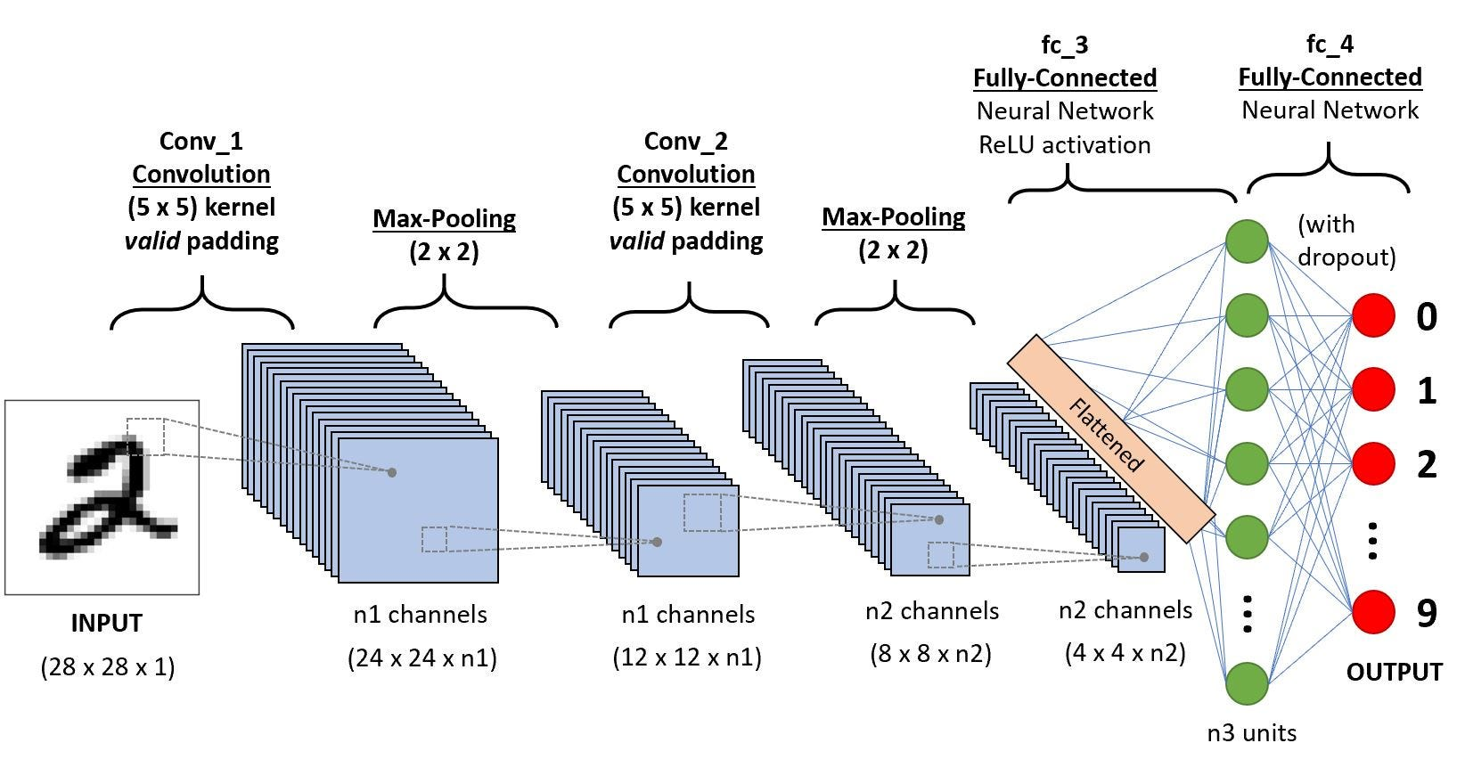
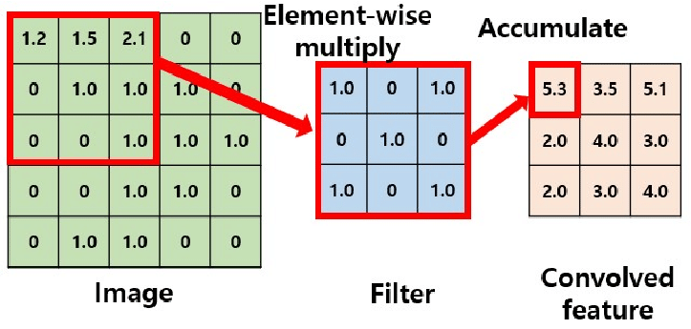
Deep Learning – Convolutional Neural Networks
Convolutional Neural Networks
Convolution
Translation Invariance (Pooling)
Translation Equivalence (Convolution)
Sharable Parameters (Weight Sharing)
Local-matter Signals
Ref: He et al., Deep Residual Learning for Image Recognition, In CVPR’16; Image Credits: In the public domain.

Slide 12
Model Evolution in Natural Language Processing
Image Credits: Dr. Han Hu, MSRA.

Slide 13
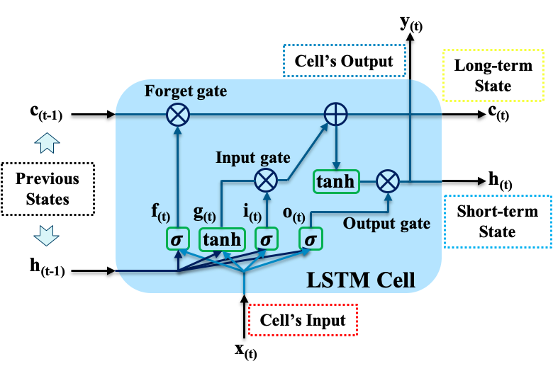
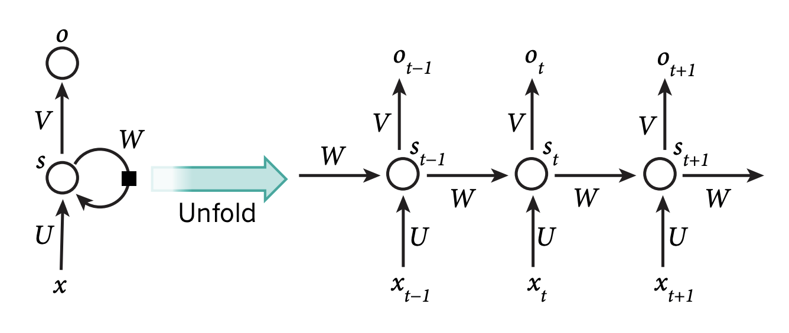
Deep Learning – Recurrent Neural Networks
unrolling the network through time
Recurrent Neural Network (RNN)
Long Short-Term Memory (LSTM)
Designed for order-matter sequential data, e.g., time series
The learned features at time step t are affected by $x_{t}$ and $x_{t−1}$ → continually learn from time series
LSTM: better capture long-range sequence dependencies
Gated Recurrent Units (GRU): lightweight architecture with comparable performance
Image Credits: In the public domain and Deep Feature Mining via the Attention-Based BiLSTM-GCN for Human Motor Imagery Recognition.

Slide 14
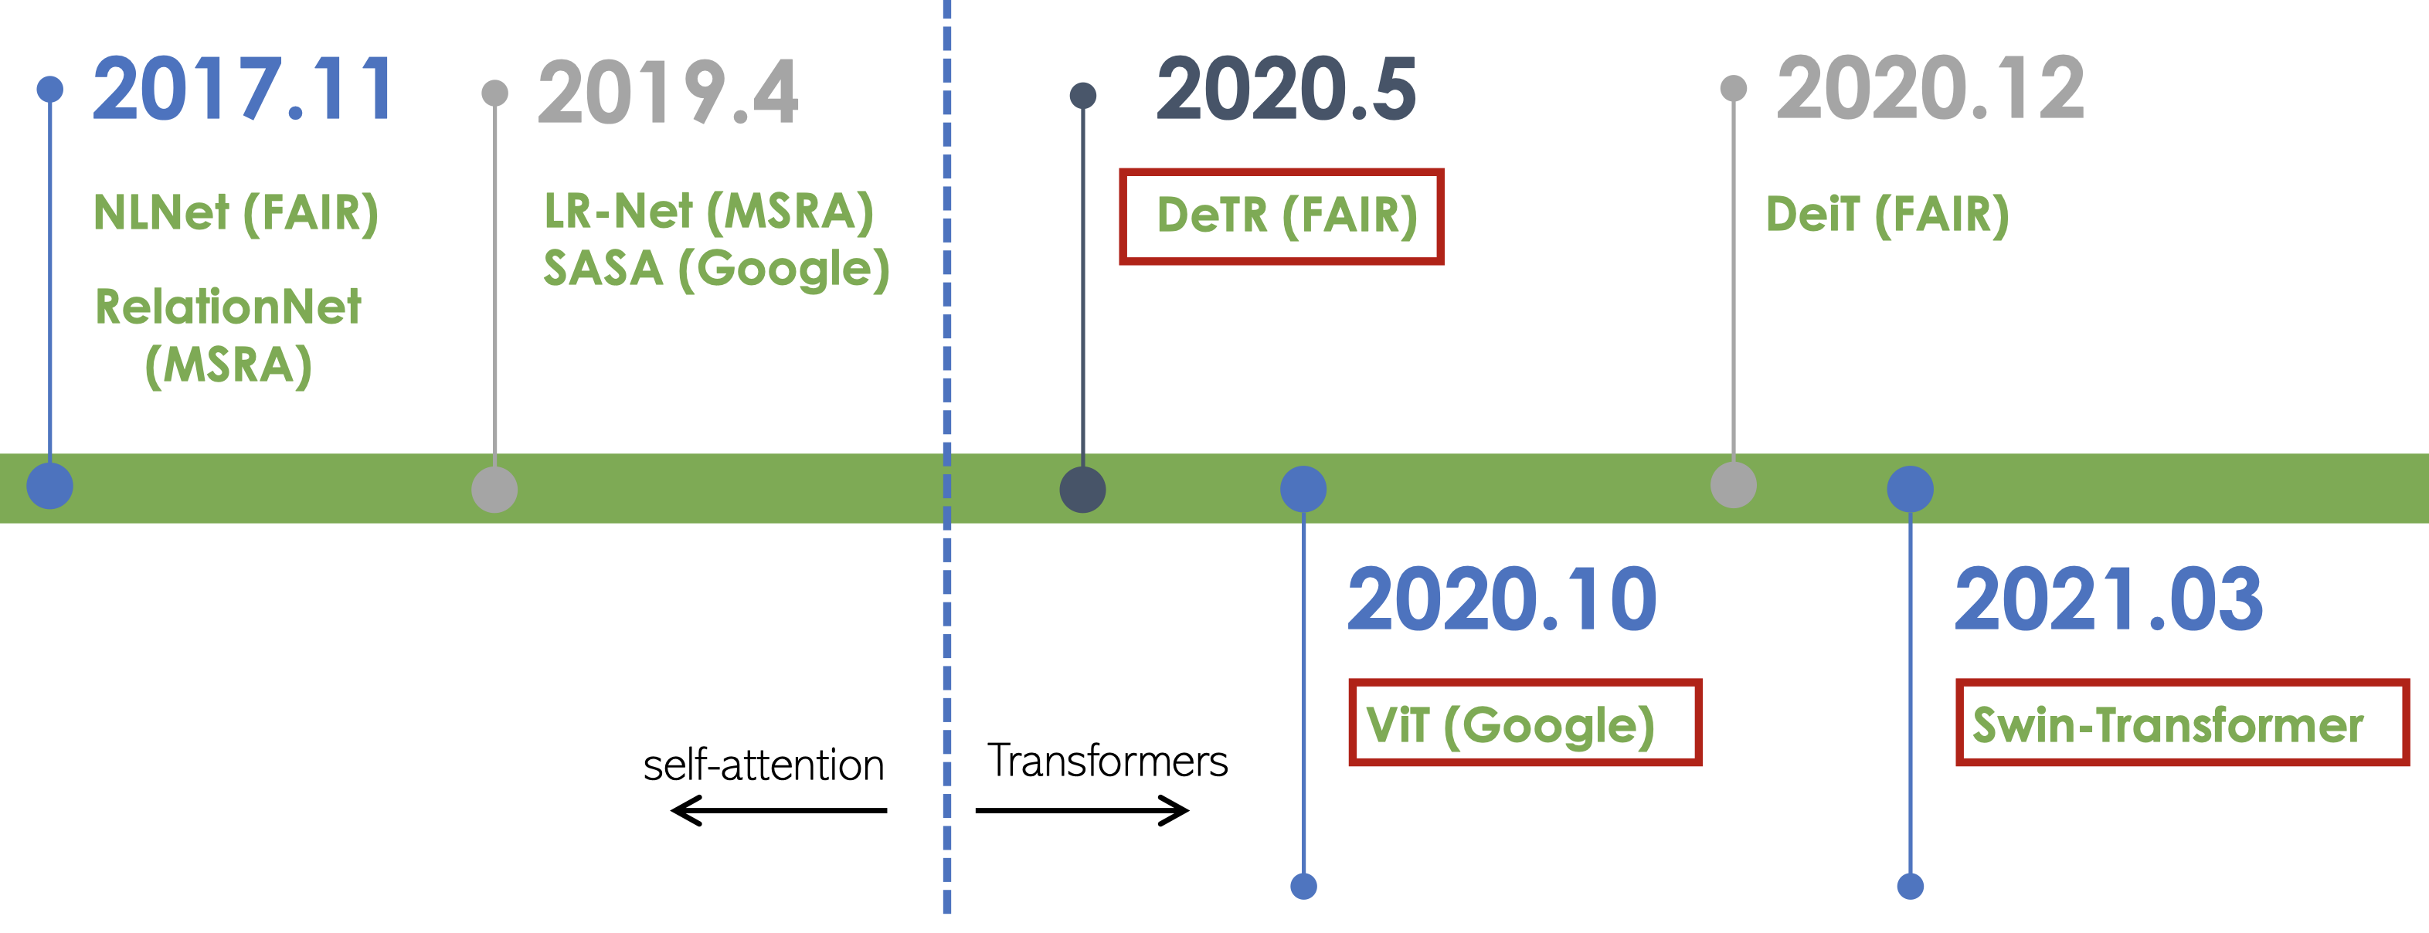
Can NLP/CV share the same basic modules?
Image Credits: Dr. Han Hu, MSRA.

Slide 15
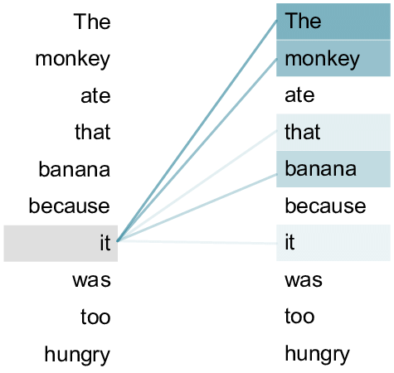
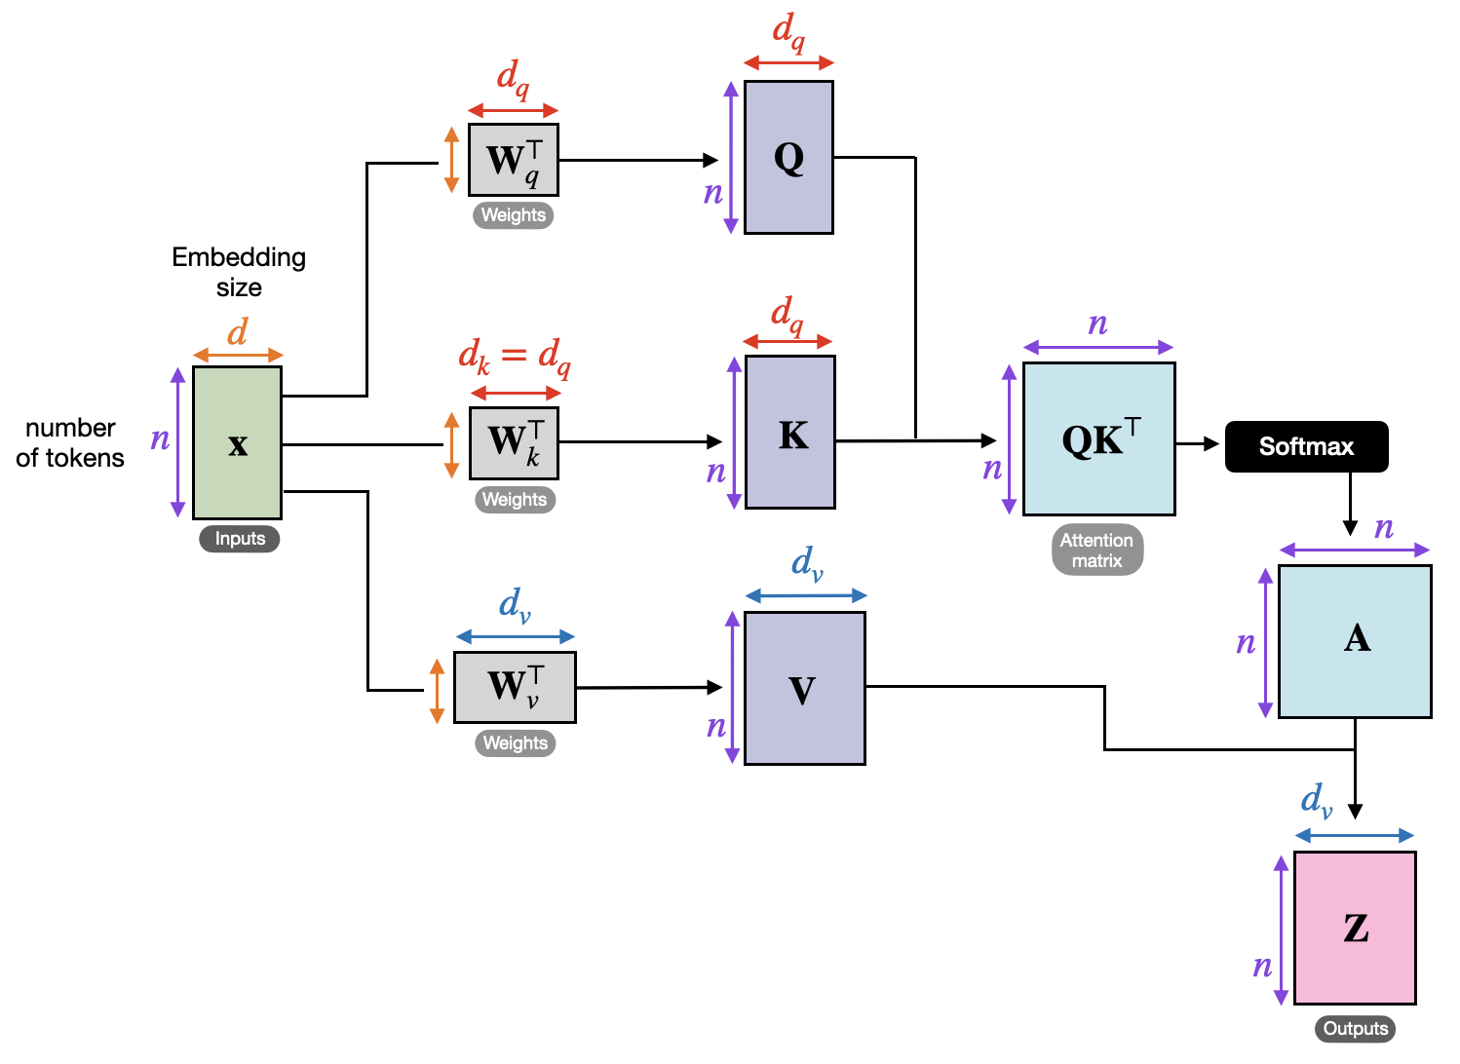
Deep Learning – Transformer
key
query
key
query
Grounding?
value
Example
(Contextual Embeddings)
Self-attention Mechanism
Transformer can simultaneously attend to every token of their input sequence
→ Transforms the token input feature by encoding its relationship with other tokens
Ref: Vaswani et al., Attention is All You Need, In NIPS’17. Image Credits: In the public domain.

Slide 16
Deep Learning – Transformer
Scaled Dot-product Attention
query
$$\left(α_{r,1},…,α_{r,T}\right)=$$
$$Softmax\left(\frac{q_{r}^{T}k_{1}}{\sqrt{d_{k}}},…,\frac{q_{r}^{T}k_{T}}{\sqrt{d_{k}}}\right)$$
query
$$q_{t}^{T}=x_{t}^{T}W^{(q)}$$
$$k_{t}^{T}=x_{t}^{T}W^{(k)}$$
$$v_{t}^{T}=x_{t}^{T}W^{(v)}$$
key
key
value
value
Self-attention Mechanism
$$z_{r}=α_{r,1}×v_{1}+…+α_{r,T}×v_{T}$$
A weighted average of Value,
where the weight is the normalized inner product of Query and Key
Image Credits: In the public domain.

Slide 17
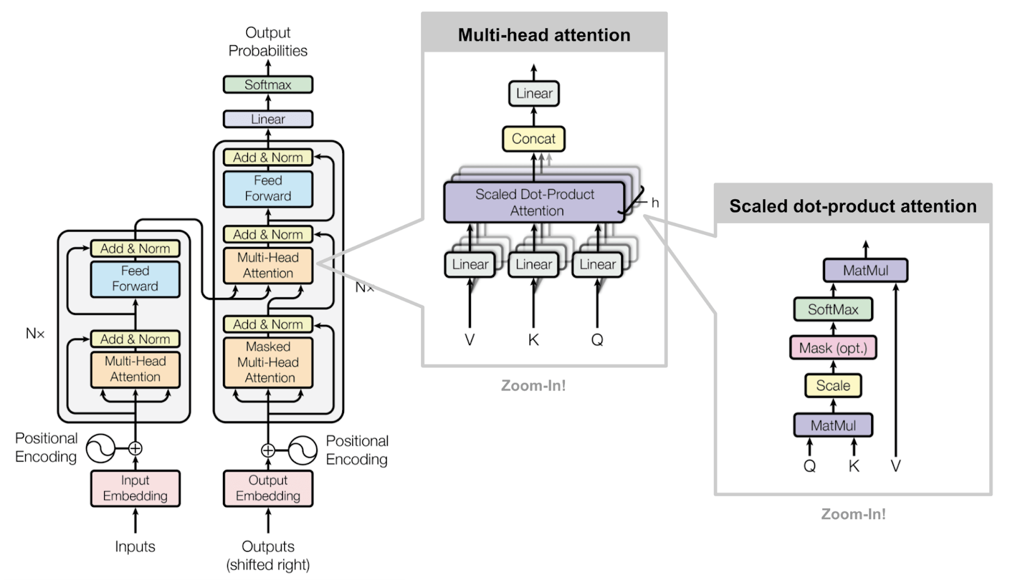
Deep Learning – Transformer
Towards Universal Models with NLP for Computer Vision
Image Credits: In the public domain.

Slide 18
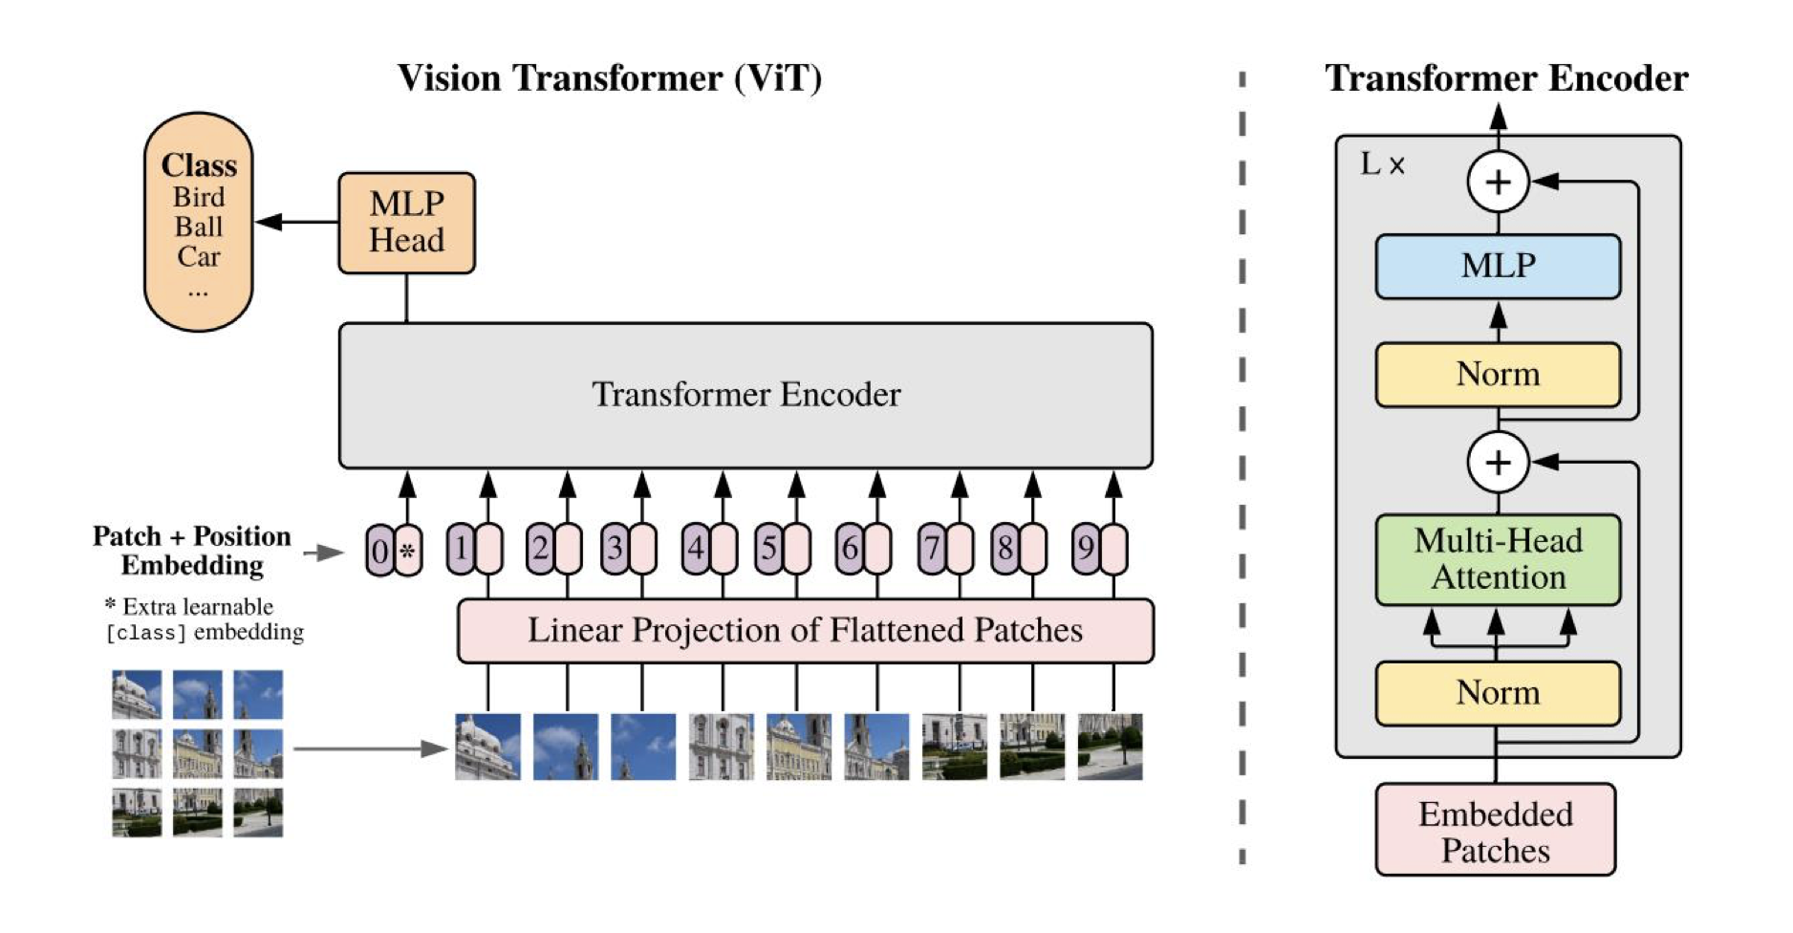
Vision Transformers for Image Recognition
Image Patches $→$ Sequence
Ref: Dosovitskiv et al., An Image is Worth 16x16 Words: Transformers for Image Recognition at Scale, In ICLR’21.

Slide 19
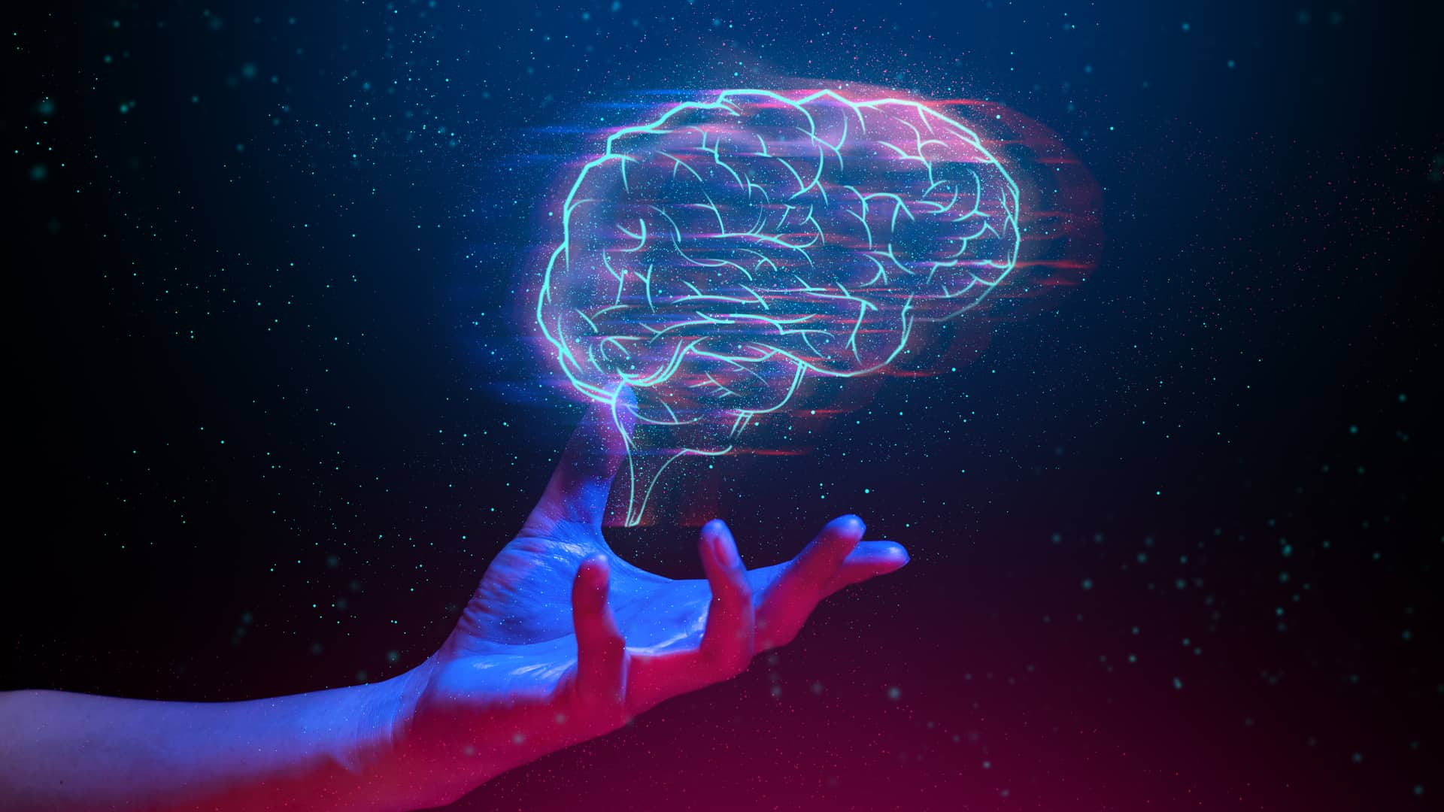
Foundation Models

Slide 20
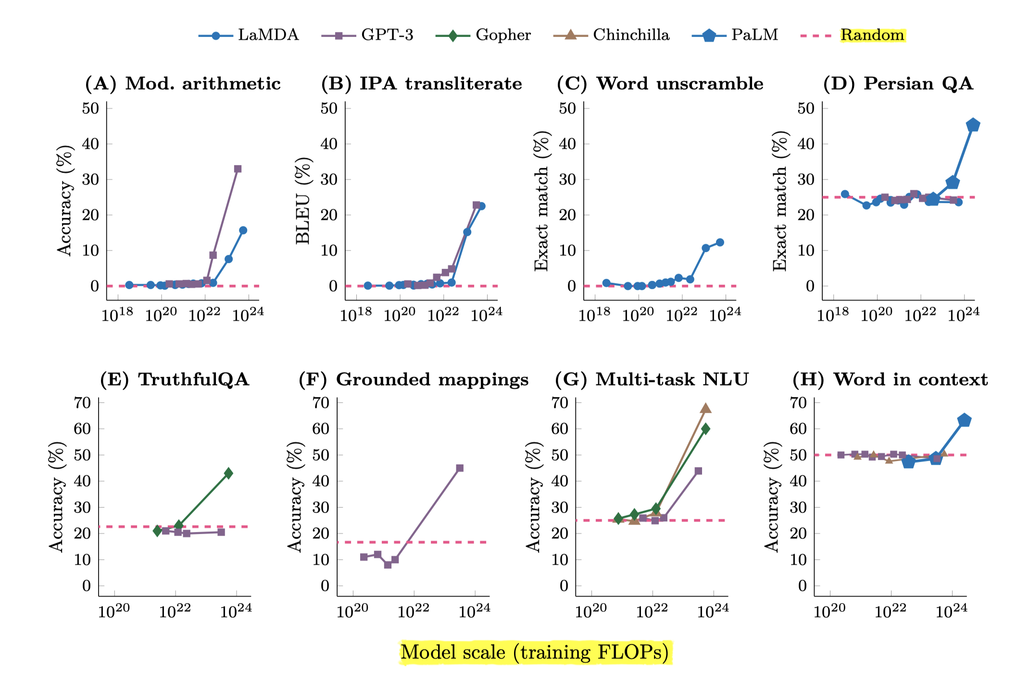
Foundation Models – Neural Scaling Laws
An ability is emergent if it is not present in smaller models but is present in larger models.
Scaling Behavior
Ref: Kaplan et al., Scaling Laws for Neural Language Models, In arXiv. and Wei et al., Emergent Abilities of Large Language Models, In TMLR’22.

Slide 21
Foundation Models – Neural Scaling Laws
Paradigm Shift
USA Frontier
Image by courtesy of Prof. Liang et al.

Slide 22
Foundation Models – Neural Scaling Laws
Paradigm Shift
Image by courtesy of Prof. Liang et al.

Slide 23
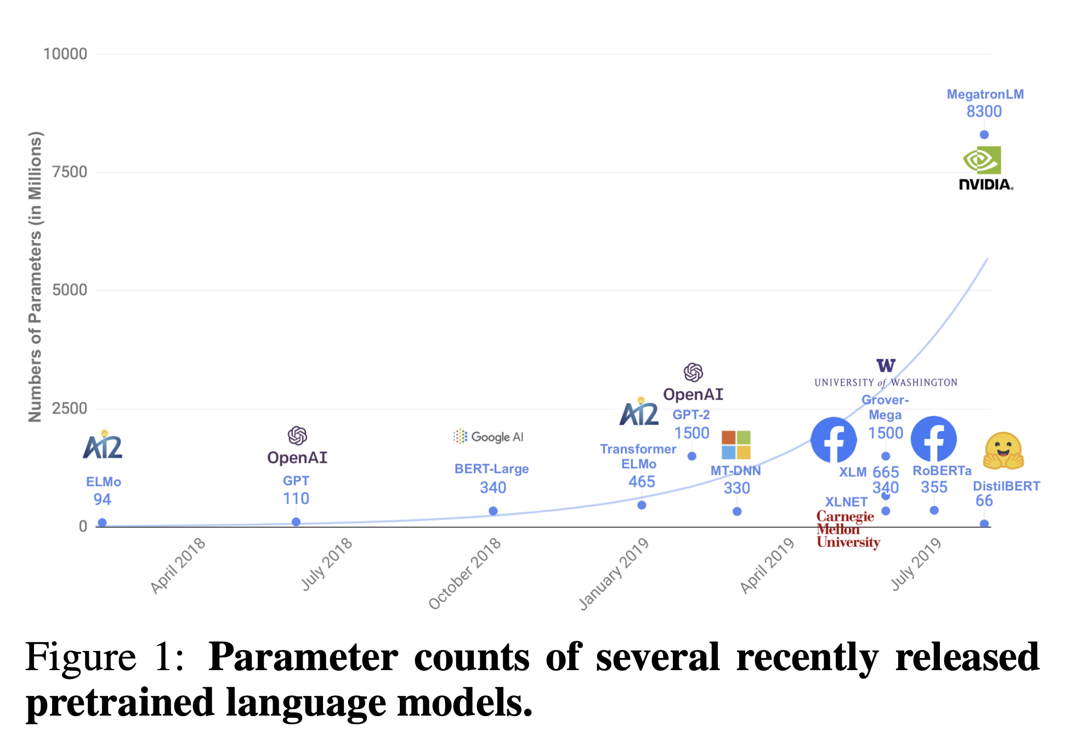
Foundation Models – Neural Scaling Laws
Paradigm Shift
Since 2020
Emerging in 2023
Ref: Sanh et al., DistilBERT, a Distilled Version of BERT: Smaller, Faster, Cheaper and Lighter, In arXiv.

Slide 24
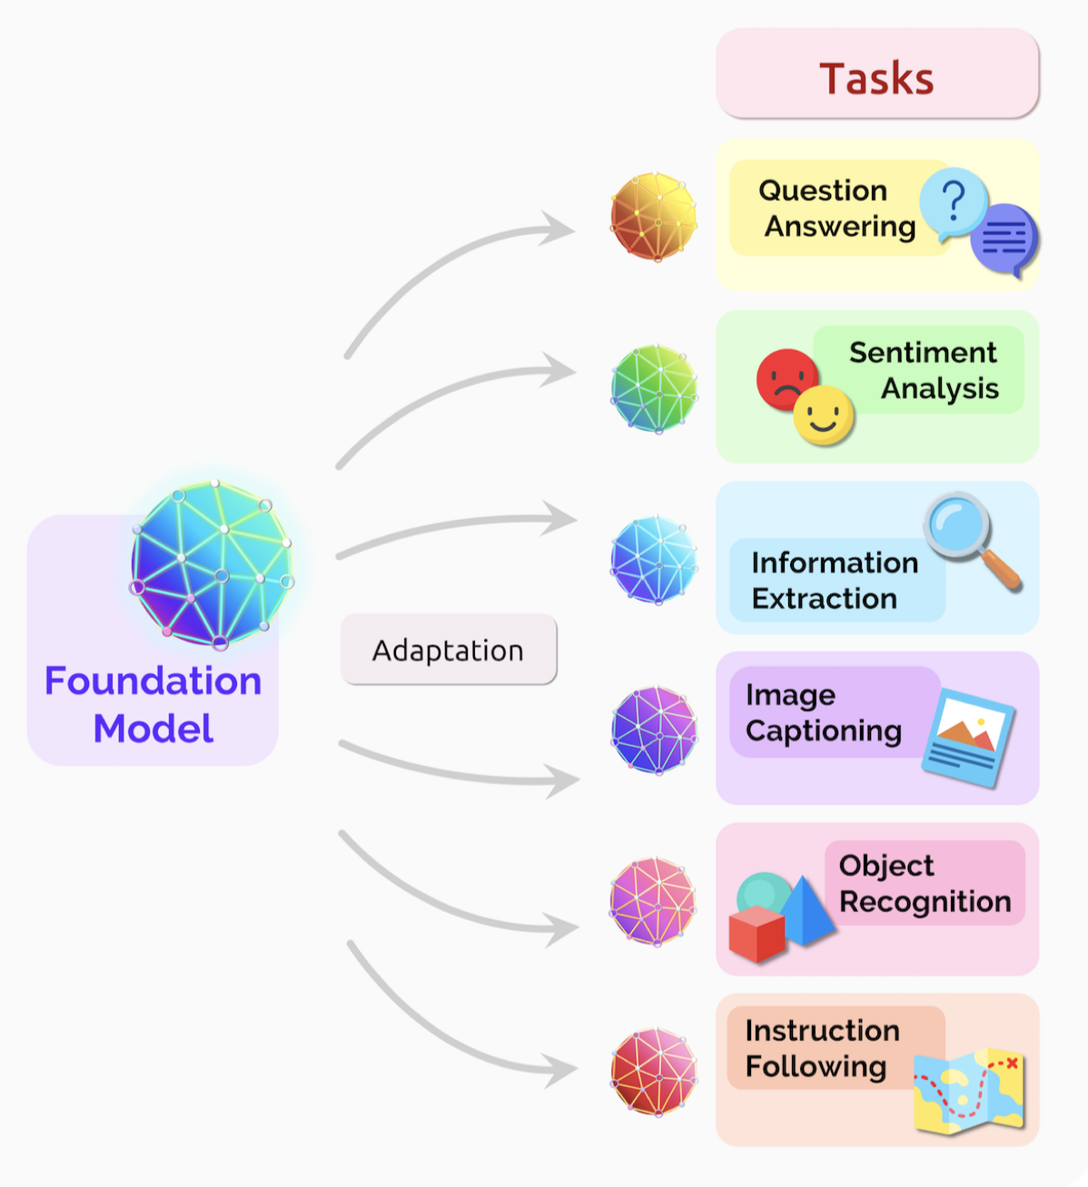
Foundation Models
What: A trillion-scale model that is trained on broad data (generally using self-supervision at scale) that can be adapted (e.g., fine-tuned) to a wide range of downstream tasks (token elements of arbitrary sequences).
e.g., GLaM dataset: 1.6 trillion tokens of webpages, forums, books, news, etc.
Why: Emergence (implicitly induced) and Homogenization
How: Self-Attention + Self-Supervision
Category: (1) Autoencoder (e.g., BERT) $←$ Encoder-only (2) Autoregressive (e.g., GPT) $←$ Decoder-only (3) Transformer Encoder-Decoder (e.g., Transformer)

Slide 25
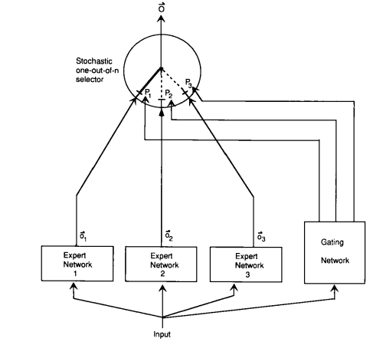
$$f\left(x\right)=\sum_{e=1}^{E}{g_{e}\left(x\right)∙h_{θ_{e}}\left(x\right)}$$
Part 4 - Foundation Models
Gradient Backprop:
Switch Routing
(e.g., Top-1 Expert)
a pooling or aggregation mechanism
probability-like confidence score
for each expert
Divide-and-conquer Strategy
$$g_{e}\left(x\right)=\frac{exp\left(W_{e}∙x\right)}{\sum_{e^{′}=1}^{E}{\left(exp\left(W_{e^{′}}∙x\right)\right)}}$$
Expert
Gating Network
Note: (1) Token-level
(2) Block-level
Subtask/Sub-feature
Mixture of Experts (MoE)
Train Experts on subtasks of a predictive modeling problem
Ref: Jacobs et al., Adaptive Mixtures of Local Experts, In Neural Computation’1991.
Another ref: https://stanford-cs324.github.io/winter2022/lectures/selective-architectures/;

Slide 26
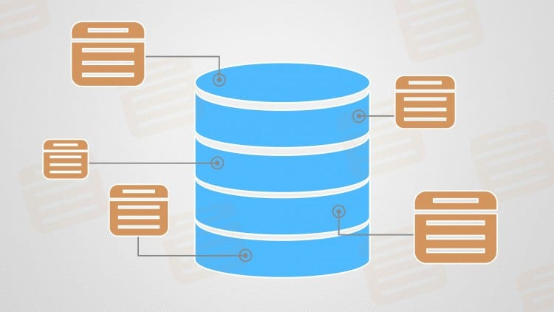
$$p\left(y|x\right)=\sum_{z∈S}{p\left(z|x\right)p\left(y|z,x\right) }$$
Part 4 - Foundation Models
Output
Input
$$y$$
$$x$$
Generator
$$p\left(y|z,x\right)$$
Retriever
Retrieval-augmented
$$p\left(z|x\right)$$
Top-K MoE
interpretability
Image Credits: Prof. Edward Chang et al., Stanford

Slide 27
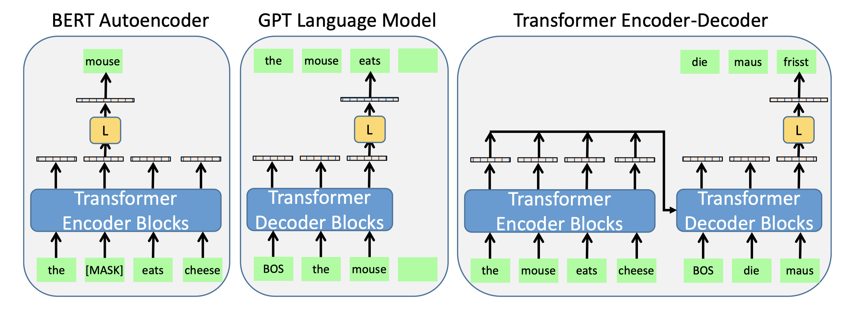
Ref: Paaß et al., Foundation Models for Natural Language Processing, In Springer’23.
Foundation Models – Category
Contextual Embedding (Undirectional) +
Distribution over the next token +
Recursively over the entire completion
Contextual Embedding (Bidirectional) +
Generate the output
Contextual Embedding
(Bidirectional)

Slide 28
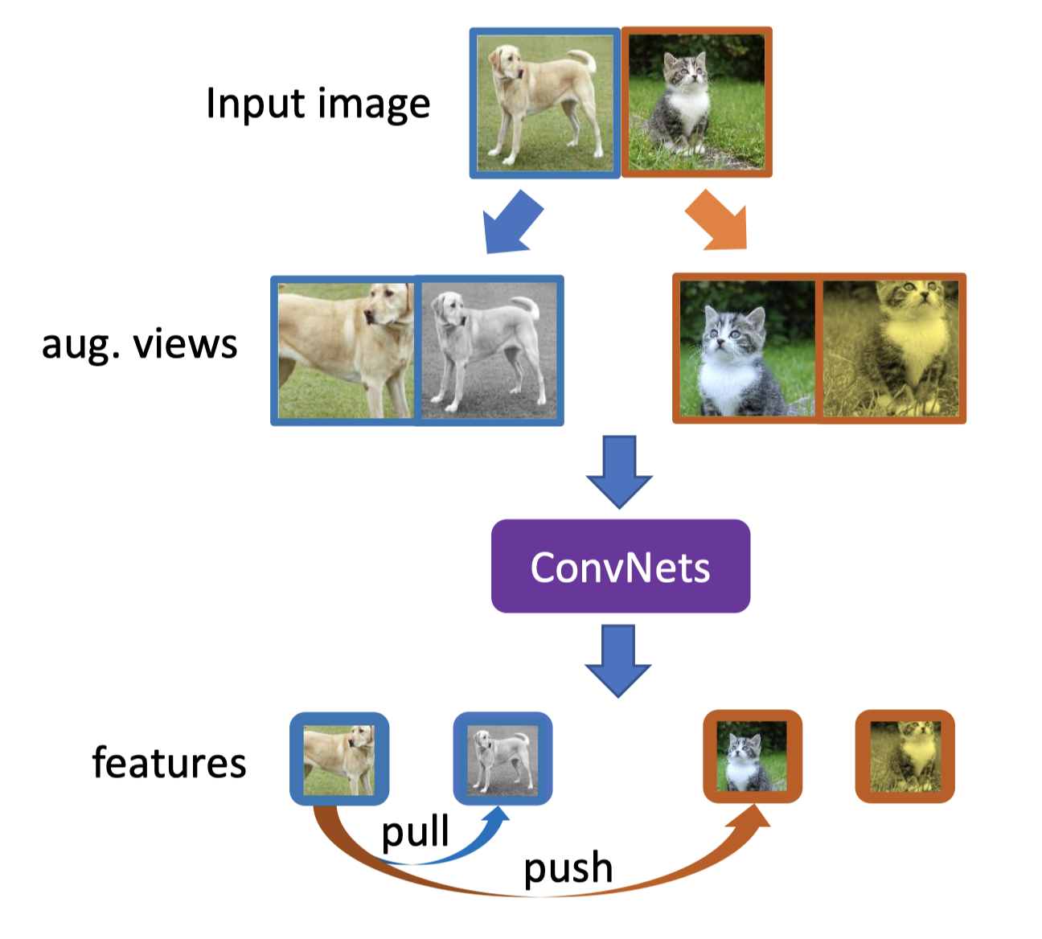
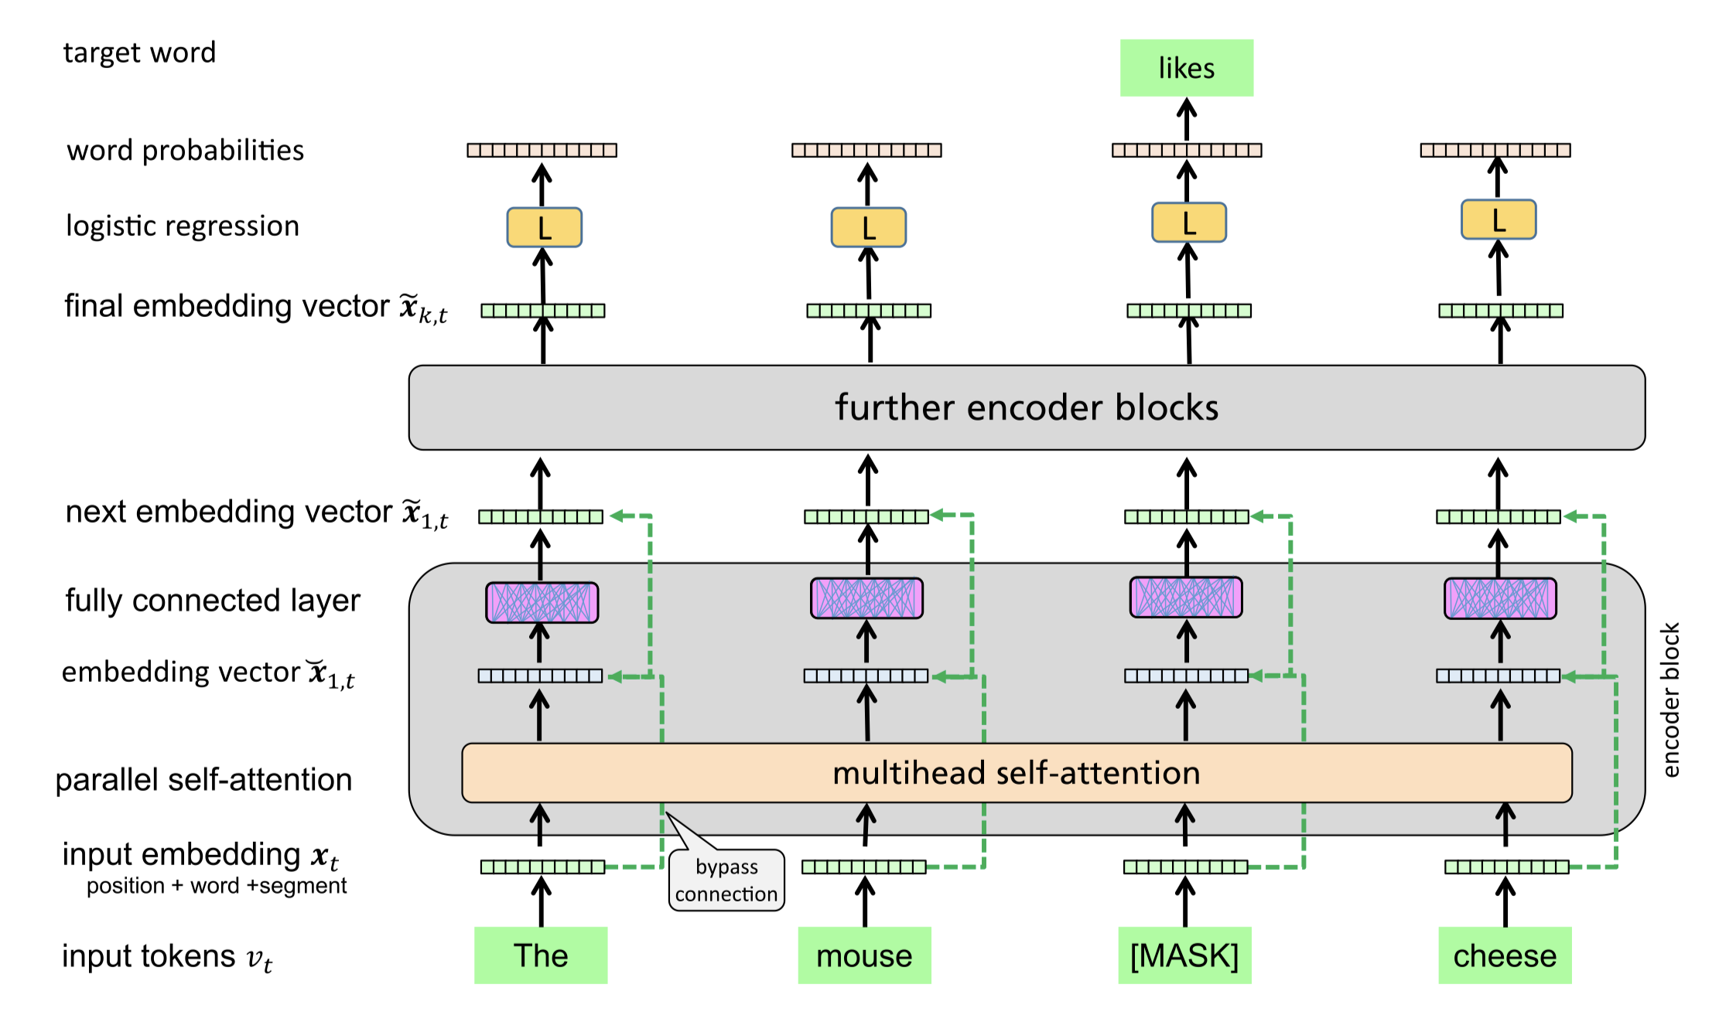
Foundation Models – Self-supervision
Learning from unlabeled large-scale dataset through Self-supervised Learning.
Ref: Paaß et al., Foundation Models for Natural Language Processing, In Springer’23.

Slide 29
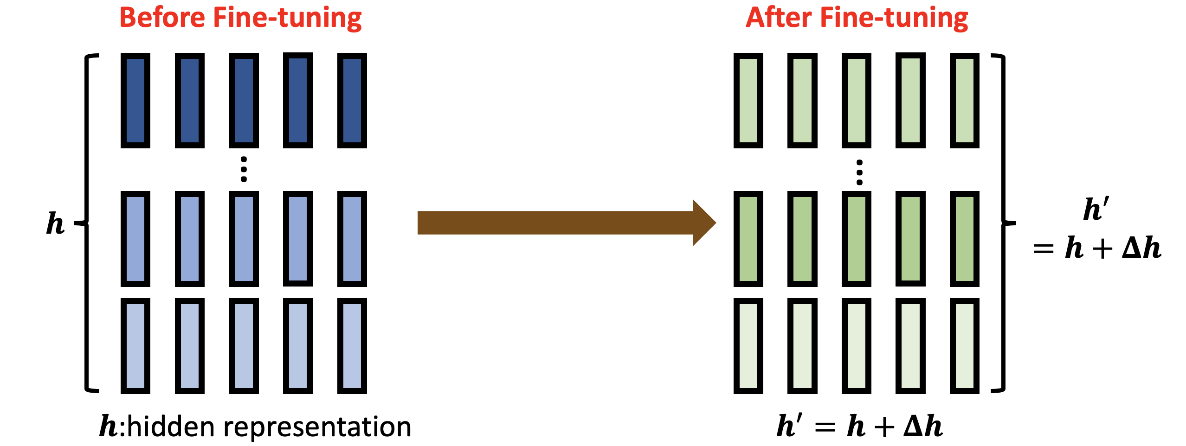
Foundation Models – Adaptation
(Fine-tuning)
Simple method: Modifying the hidden representation
Other methods ref: https://d223302.github.io/AACL2022-Pretrain-Language-Model-Tutorial/

Slide 30
Foundation Models – Adaptation (Prompting)
Eiffel Tower is located in the city of
Prompt: template (query, or description) with instructions, goals, and examples
Few-shot Learning

Slide 31
Foundation Models – Significance
Generation Capability → Generative AI Creativity
Representation Capability Memorizing and Reasoning
Image by courtesy of Prof. Huang, NTU.
Notes:
Because of the powerful Generation and Representation Capability, current AI not only has creativity to generate new things, it can also memorize and conduct reasoning, like living things.

Slide 32
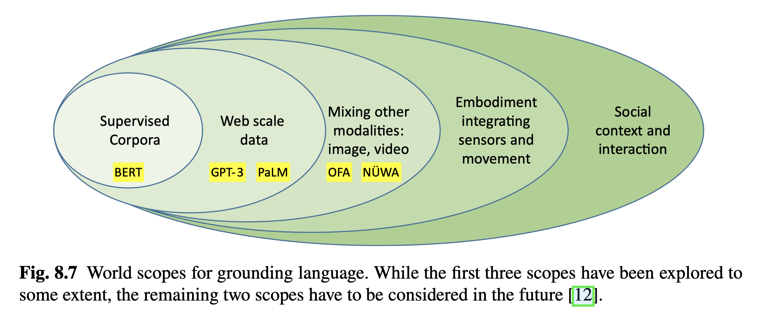
Part 5 - Advanced AI Systems
AGI = highly autonomous systems that outperform humans
at most economically valuable work
Ref: Paaß et al., Foundation Models for Natural Language Processing, In Springer’23.

Slide 33
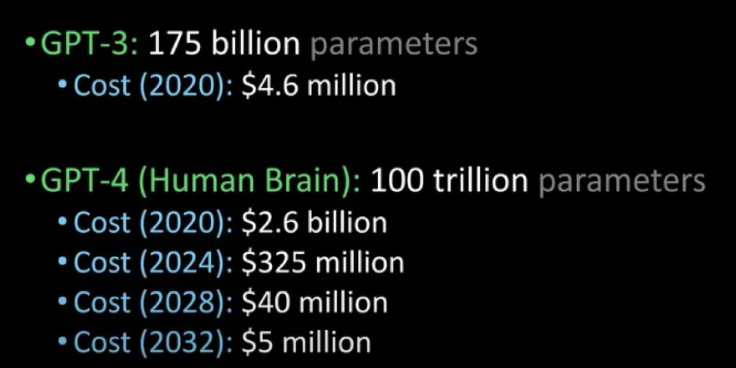
Expectations in 2023 - 2030
1. Foundation Models
2. Generative AI
3. Grounding Foundation Models
4. Analyze and Process AI-generated Content
5. Safe, Secure, Responsible, and Trustworthy AI Systems
6. Multi-Domain Data Integration
7. Interpretable, Reliable, and Sustainable AI
Understanding is All Machines Need!
Image Credits: Prof. C.-C. Jay Kuo, USC.
GPT-4: a mixture of 8 $×$ 220-billion-parameter model.

Slide 34
Thank you very much for your attention!

